Slide 1


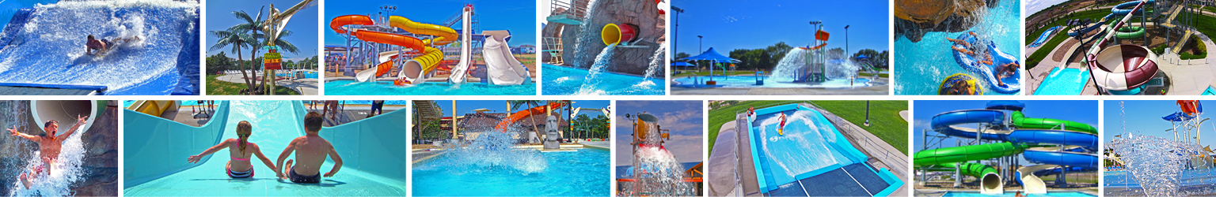
Roeland Park Aquatic Center
Project Update
June 3, 2019

Slide 2
Updated Layout and Costs

Slide 3
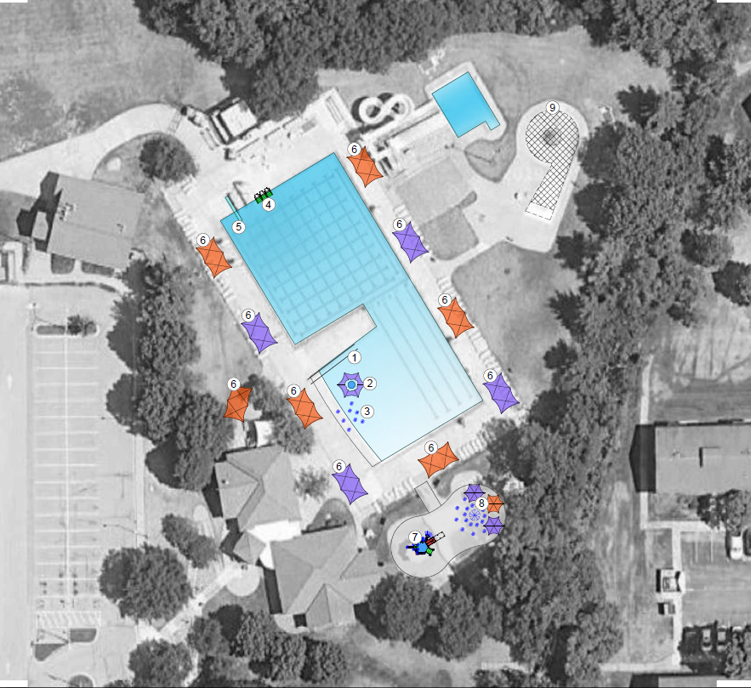
Layout 1 – Basic Improvements
Demo vortex, slides and plunge pool
Add shade structures (10)
Remove wading pool/sand area
Add wet deck and play structure
Zero-depth sprays, bench & shade
Add ADA ramp
New security lighting
Soften with landscaping

Slide 4
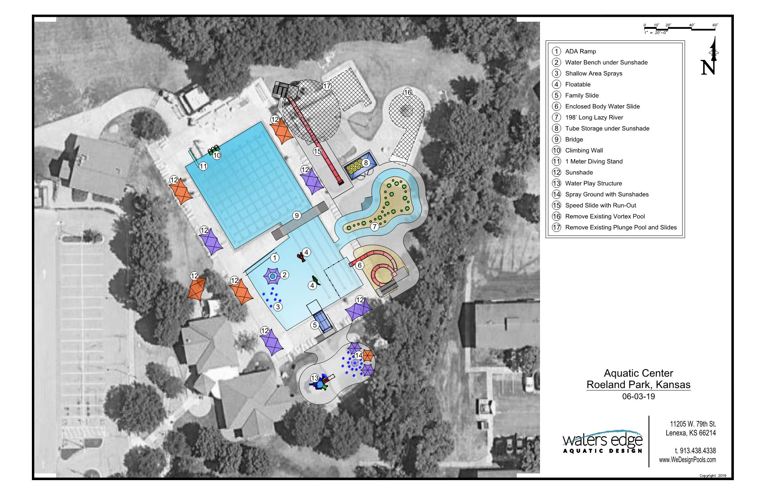
Layout 1 with Options

Slide 5
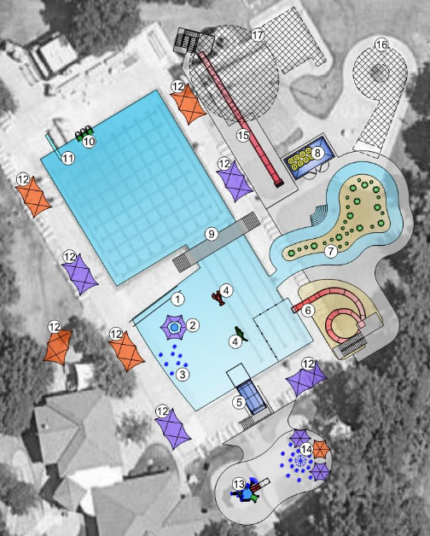
Project Costs for Options
Project Costs
Floatables $ 20,000
Full night lighting $ 55,000
Family slide $135,000
Bridge $120,000 for wood
$200,000 for concrete
Tube slide $235,000
Speed slide $355,000
Lazy river $875,000

Slide 6
Layout 1 – Phased Options
Project Costs
Base project includes security lights, shade, toddler slide, ADA ramp, sprays and shade in pool, demo for slides and vortex pool
Base project $1.38 million
Base + floats + lights + family $1.43 million
Base + floats + lights + family + tube $1.64 million
Base + floats + lights + family + tube + bridge $1.84 million
Base + floats + lights + family + tube + bridge + speed $2.12 million
Base + floats + lights + family + tube + bridge + speed + river $3.04 million

Slide 7
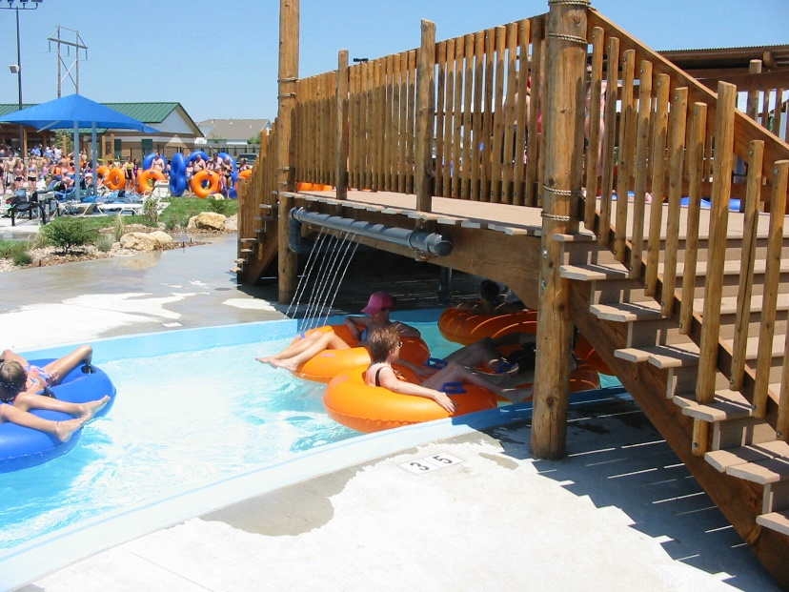
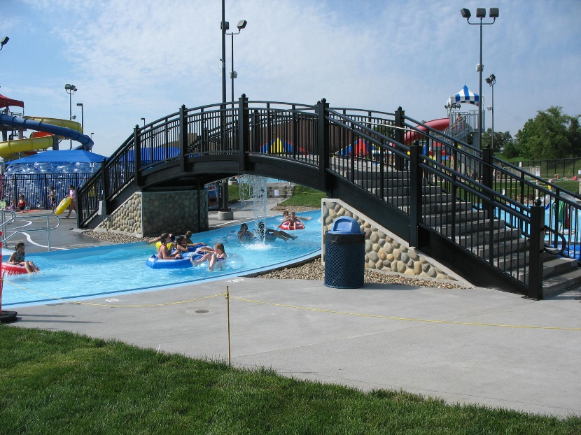
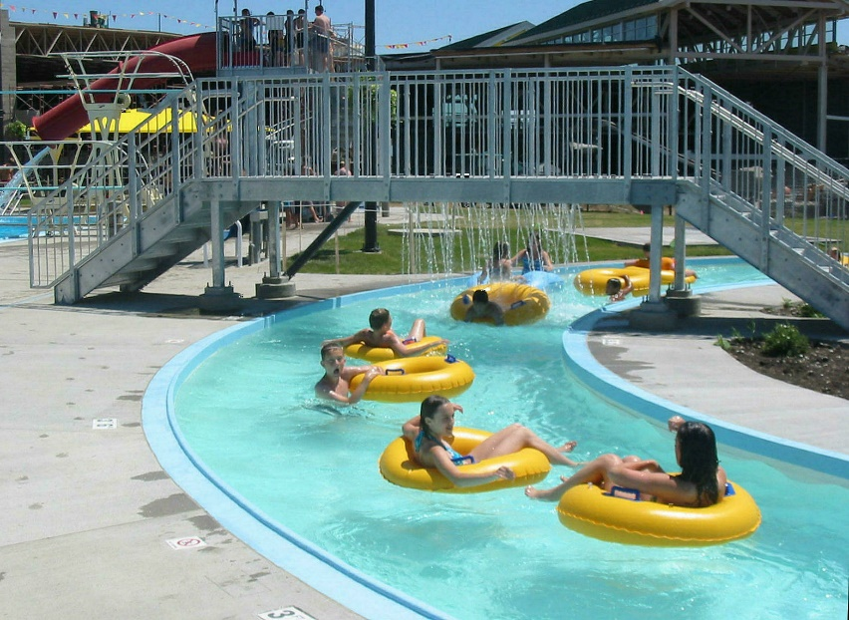
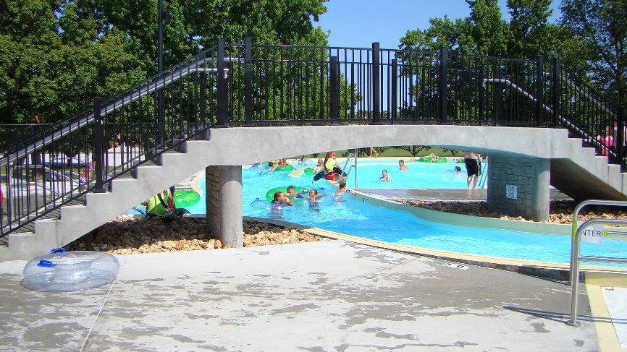
Features – Bridges
Wooden Bridge
Steel and Concrete Bridge
Spans less than 10 ft shown; 32 ft span needed
Concrete Bridge
Steel Bridge

Slide 8
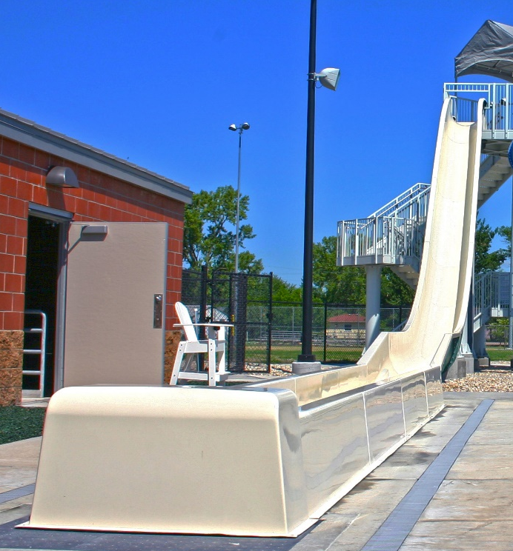
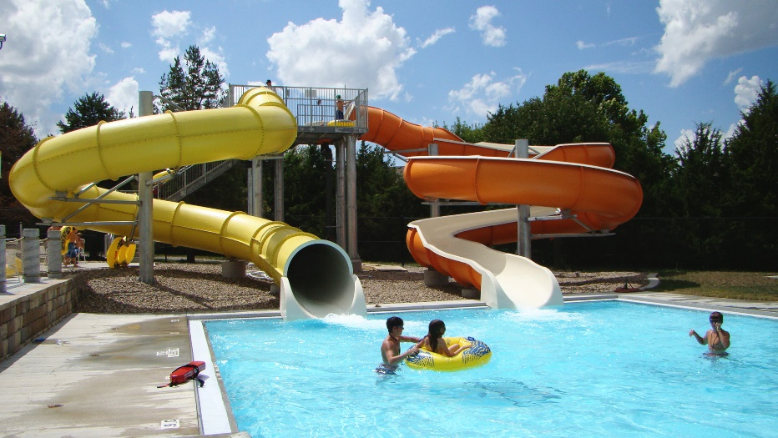
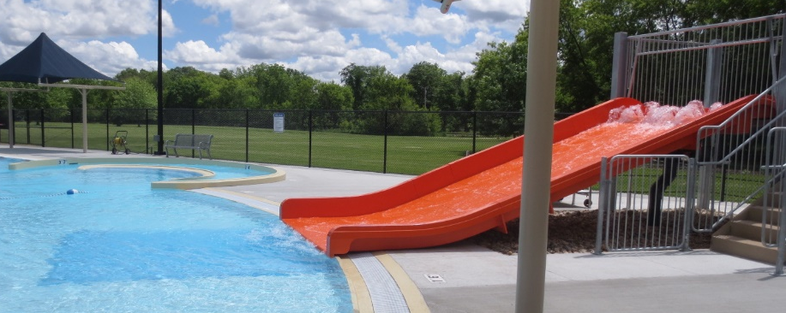
Features – Slide Options*
Open Body Slide (w/ tower)
Enclosed Body Slide
Speed Slide (Runout)
Family Slide
Anticipate 2% increase in feature cost and 5% in labor/construction costs annually

Slide 9
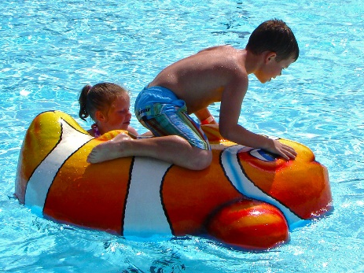
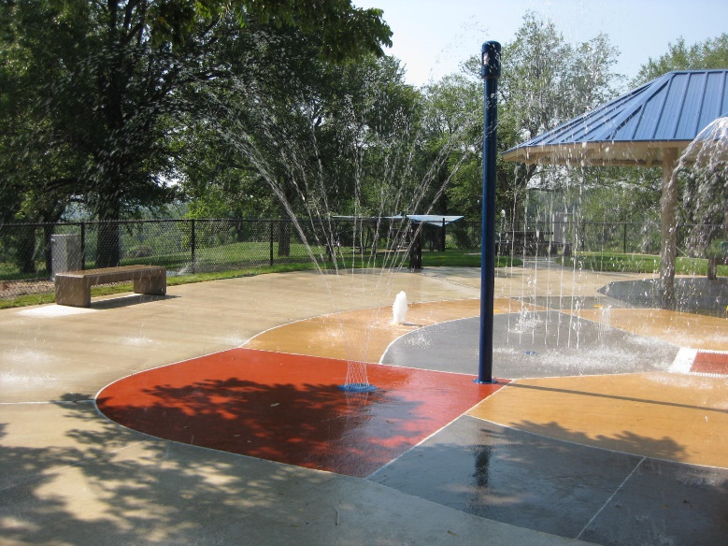
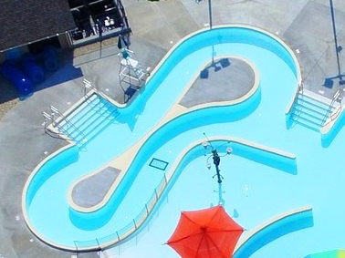
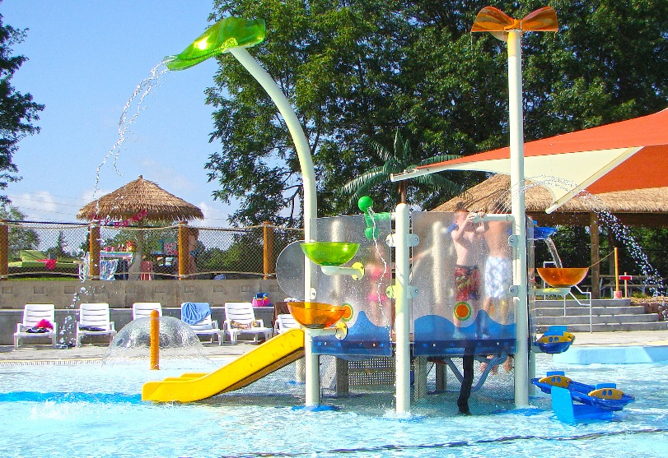
Features –Phasing Options*
Floatables (x2)
Spray Ground
Lazy River (7’, 225 l.f.)
Play Structure
Anticipate 2% increase in feature cost and 5% in labor/construction costs annually

Slide 10
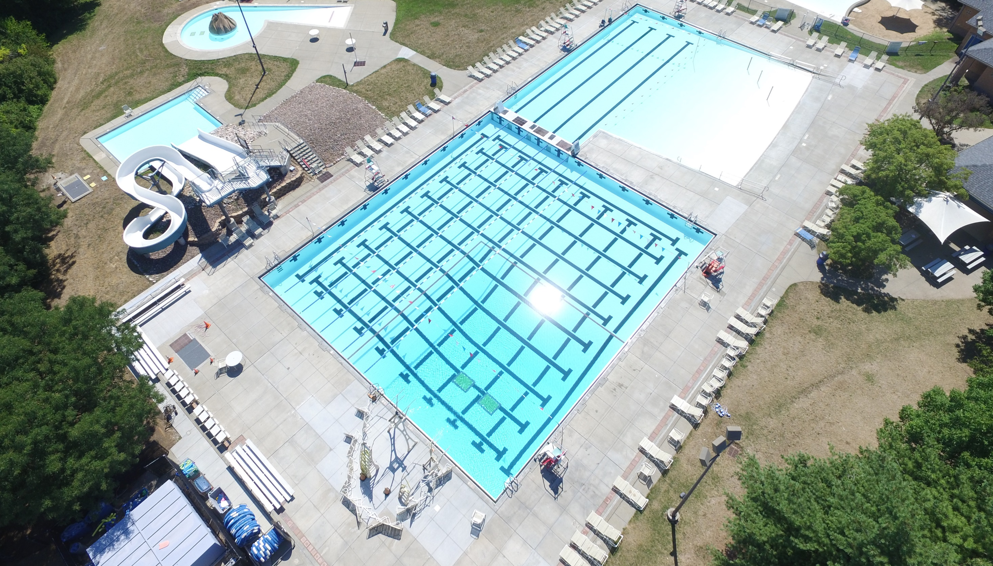
Thank you
Comments

